Slide 1
XGBoost Regressor
An Overview of Gradient Boosting for Regression

Slide 2
What is XGBoost?
XGBoost (Extreme Gradient Boosting) is an optimized distributed gradient boosting library designed to be highly efficient, flexible, and portable.
It implements machine learning algorithms under the Gradient Boosting framework.

Slide 3
Key Features of XGBoost
- High performance and speed
- Regularization to reduce overfitting
- Handling missing data
- Support for parallel computation
- Tree pruning and advanced optimization

Slide 4
XGBRegressor Parameters
• objective: Loss function (e.g., 'reg:squarederror')
• n_estimators: Number of boosting rounds (trees)
• learning_rate: Step size shrinkage used in updates
• max_depth: Maximum tree depth for base learners
• random_state: Ensures reproducibility of results

Slide 5
How XGBoost Works
1. Starts with initial prediction (e.g., mean of targets)
2. Builds trees sequentially to correct previous errors
3. Each tree learns to minimize a loss function
4. Combines all trees for final prediction
5. Uses regularization to avoid overfitting

Slide 6
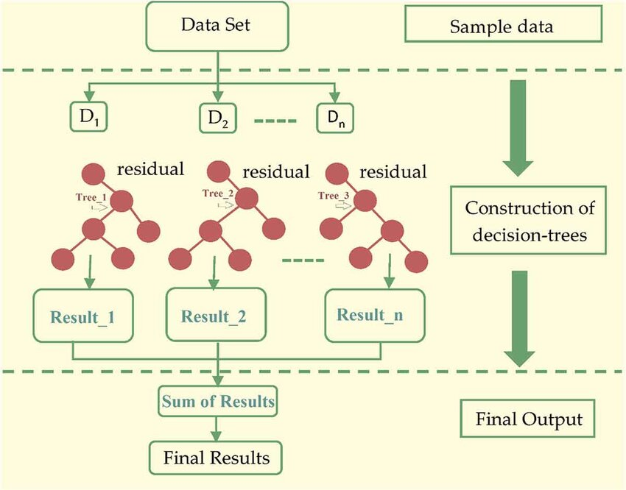
How XGBoost Works

